Slide 1
Direct measurement of J integral
Prof. Blagoj Petrovski,
University of Belgrade, Serbia
DIVK annual conference, 3.12.2020
dedicated to J.R. Rice’s 80th birthday

Slide 2
PODACI O MATERIJALU
OSNOVNI METAL
SM 80P σ_{Y}=795 MPa, σ_{U}=840MPa, σ_{Y}/σ_{U}=0,95
Av=142 J
DODATNI METAL
AUTOMATSKO ZAVARIVANJE POD PRAŠKOM
ŽICA US-80B; PRAŠAK MF-38B
σ_{Y}=585 MPa, σ_{U}=770MPa, σ_{Y}/σ_{U}=0,76
Av=83 J

Slide 3
INSTRUMENTIRANA ZATEZNA PLOČA MONTARINA U 100 t MTS MAŠINI SPREMNA ZA DIREKT J-INTEGRAL TEST

Slide 4
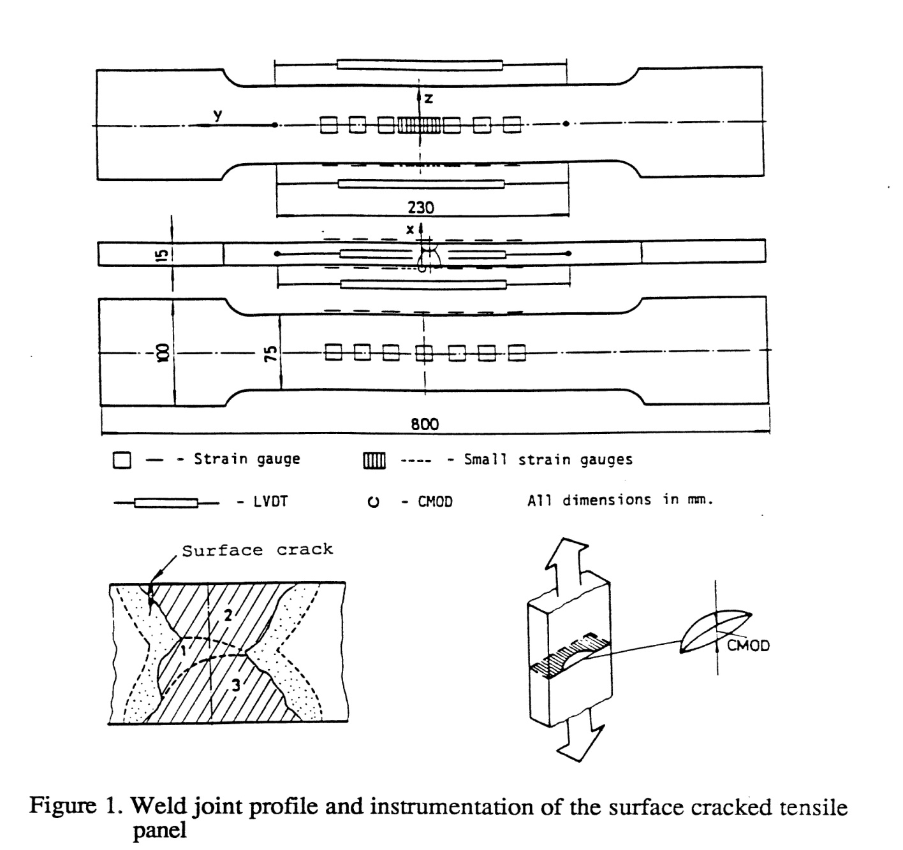
INSTRUMENTACIJA ZATEZNIH PLOČA SA POVRŠINSKOM PRSLINOM

Slide 5
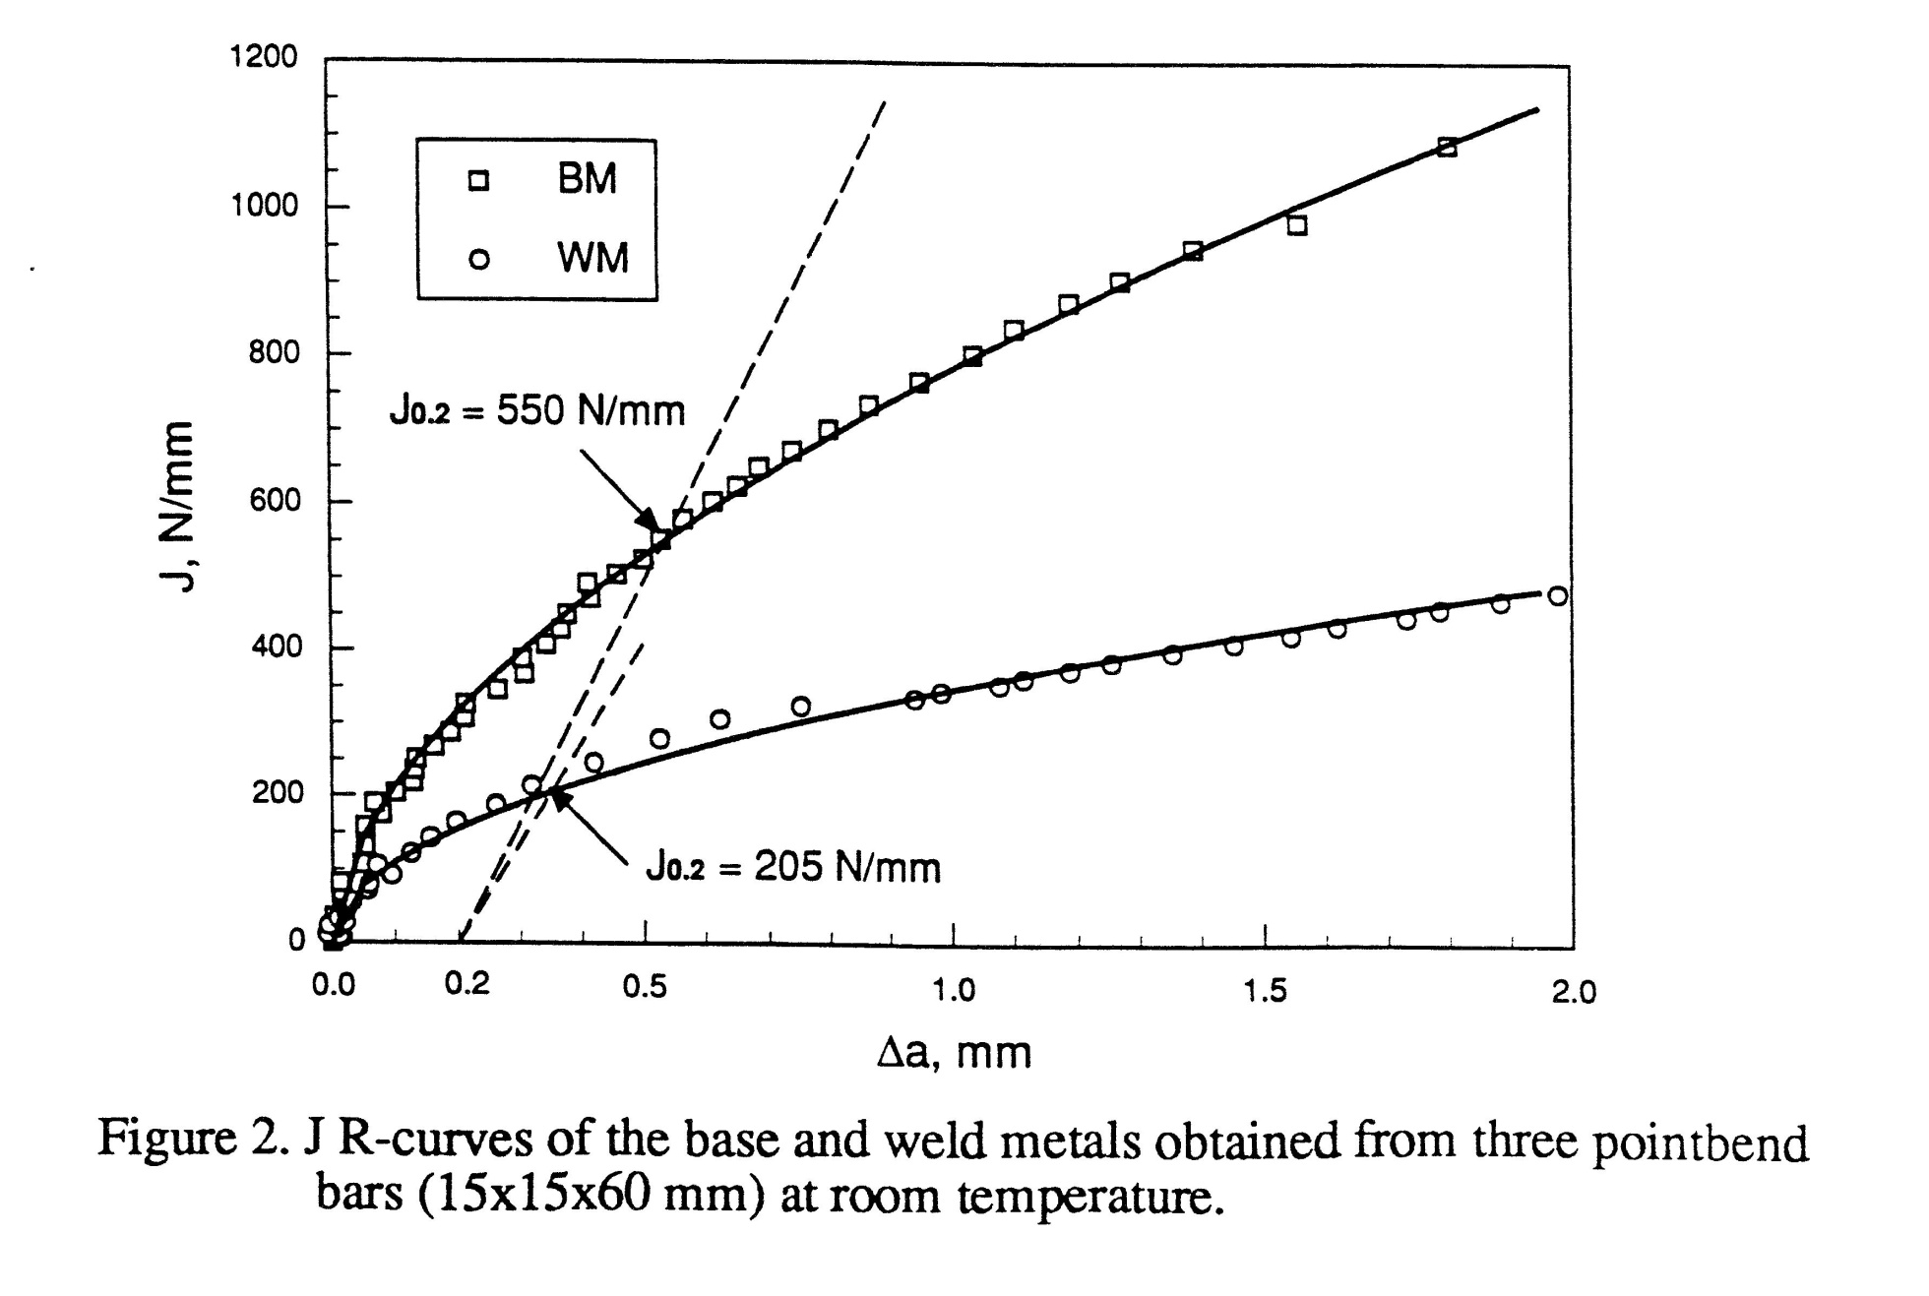
POREDJENJE J-R KRIVIH OM I MŠ

Slide 6
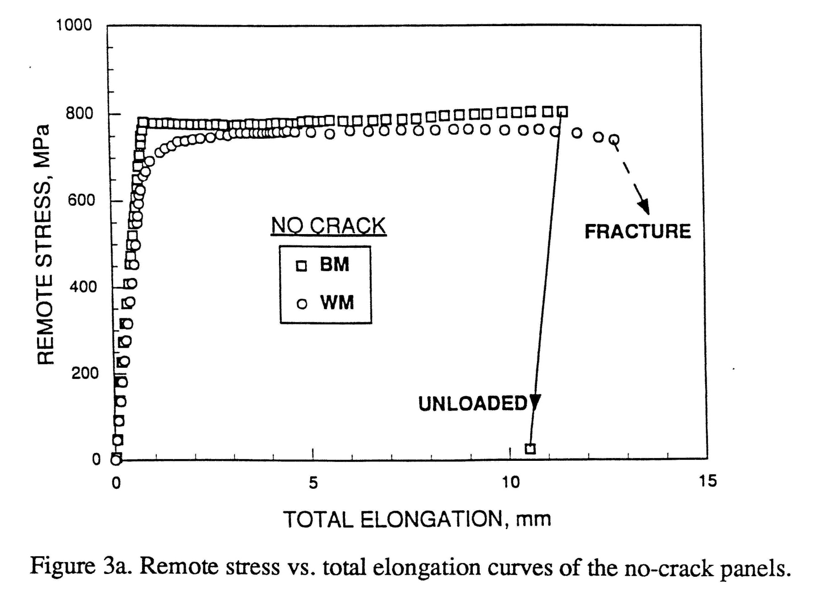
POREDJENJE ZATEZNIH KARAKTERISTIKA PLOČASTIH EPRUVETA BEZ PRSLINA

Slide 7
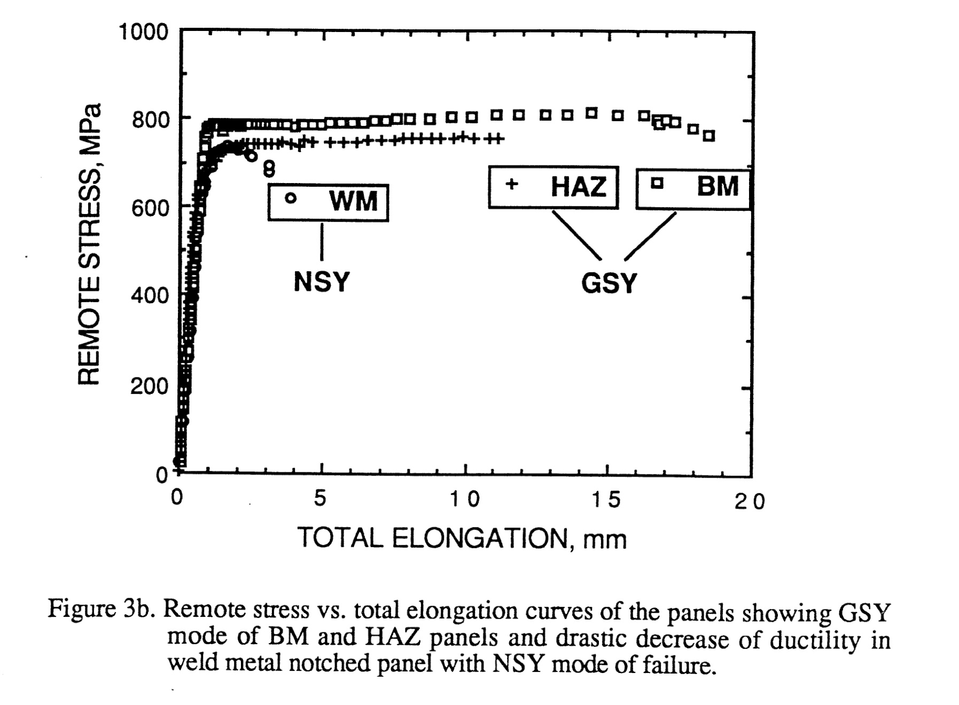
POREDJENJE ZATEZNIH KARAKTERISTIKA PLOČASTIH EPRUVETA SA PRSLINOM

Slide 8
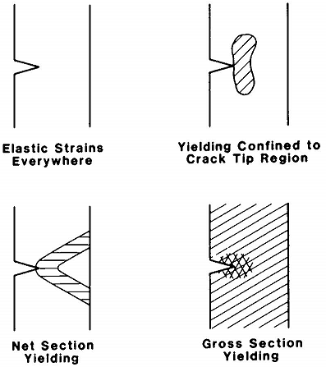
DEFORMATION PATTERNS
YIELDING PATTERNS (no bending)

Slide 9
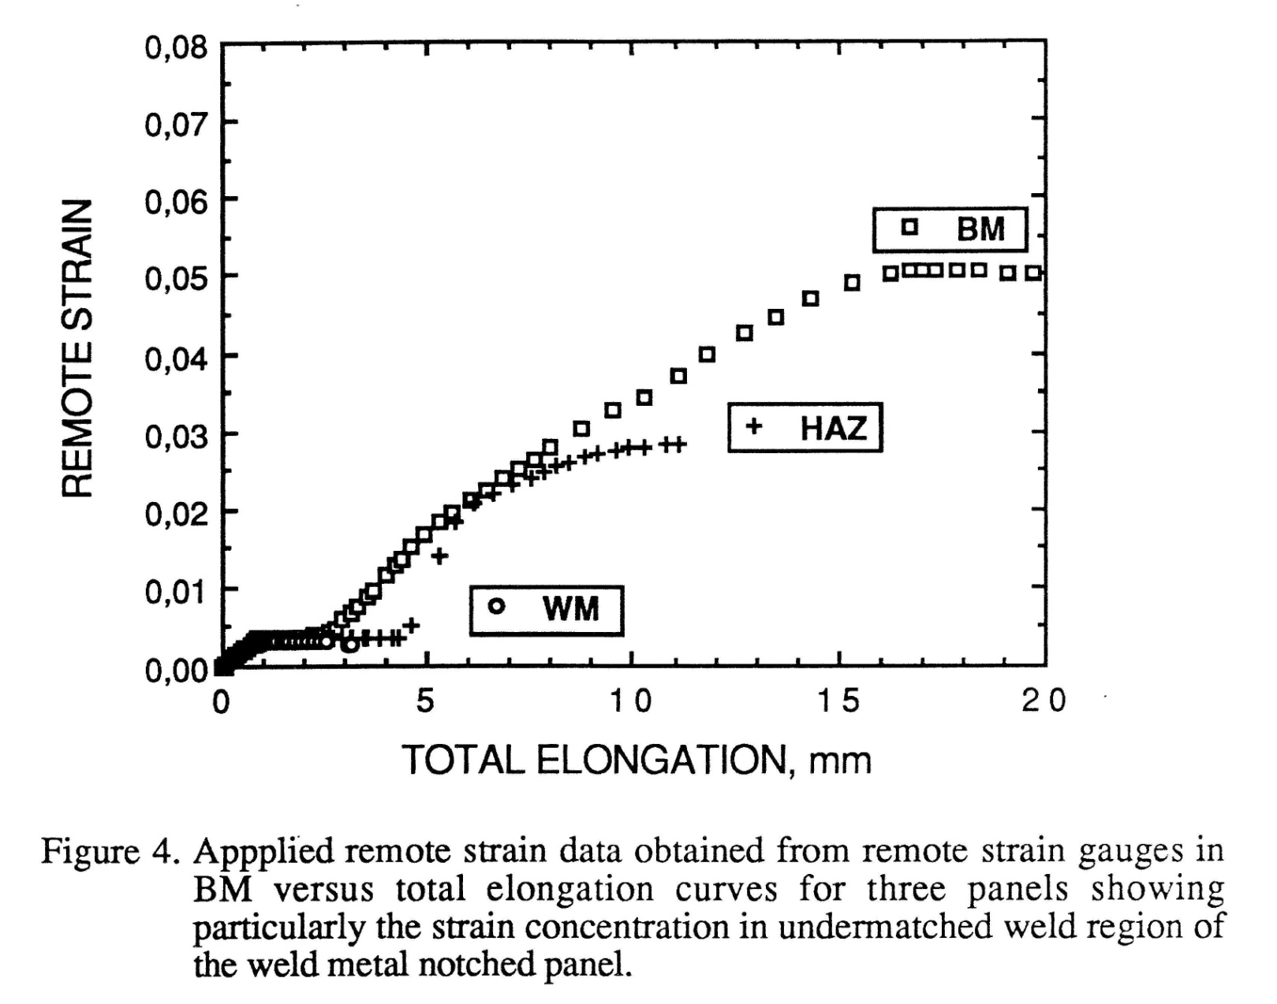
POREDJENJE UDALJENE DEFORMACIJE PLOČASTIH EPRUVETA SA TOTALNIM IZDUŽENJEM

Slide 10
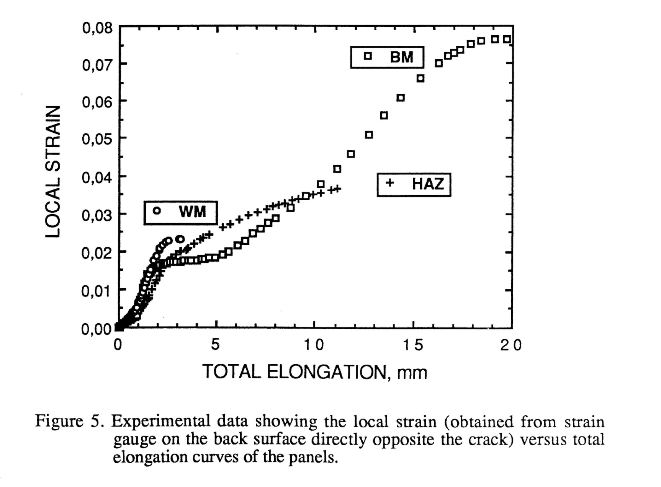
POREDJENJE LOKALNE DEFORMACIJE PLOČASTIH EPRUVETA SA TOTALNIM IZDUŽENJEM

Slide 11
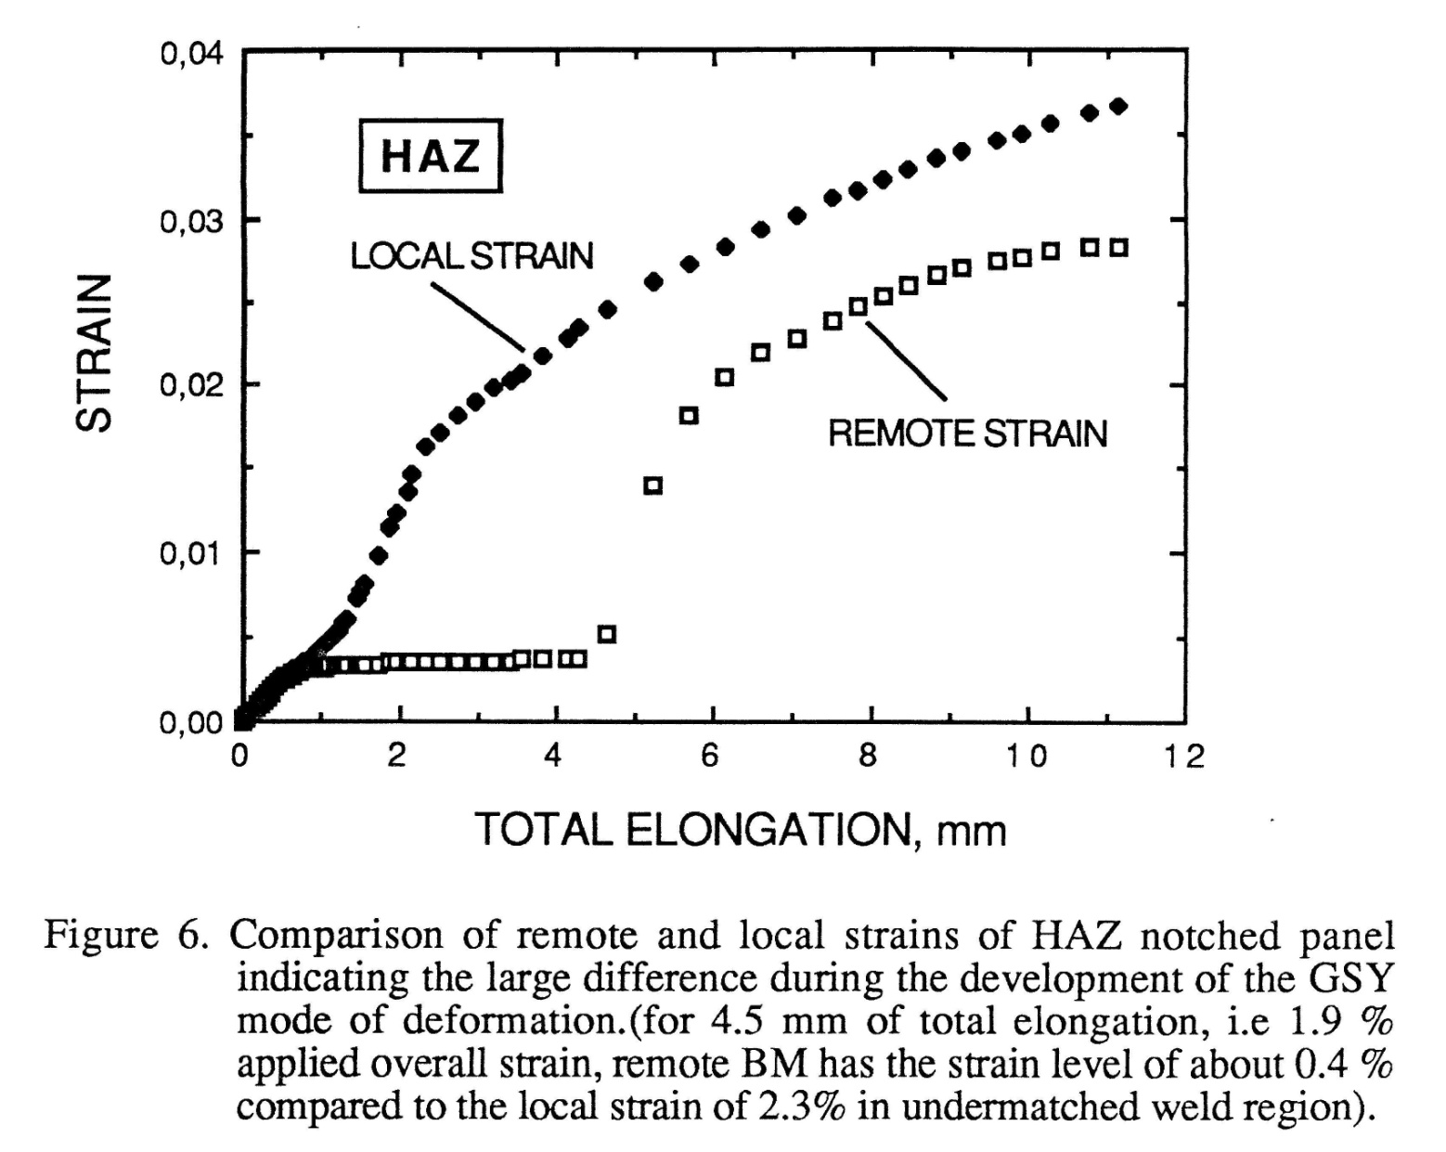
UPOREDJENJE UDALJENE I LOKALNE DEFORMACIJE SA IZDUŽENJEM

Slide 12
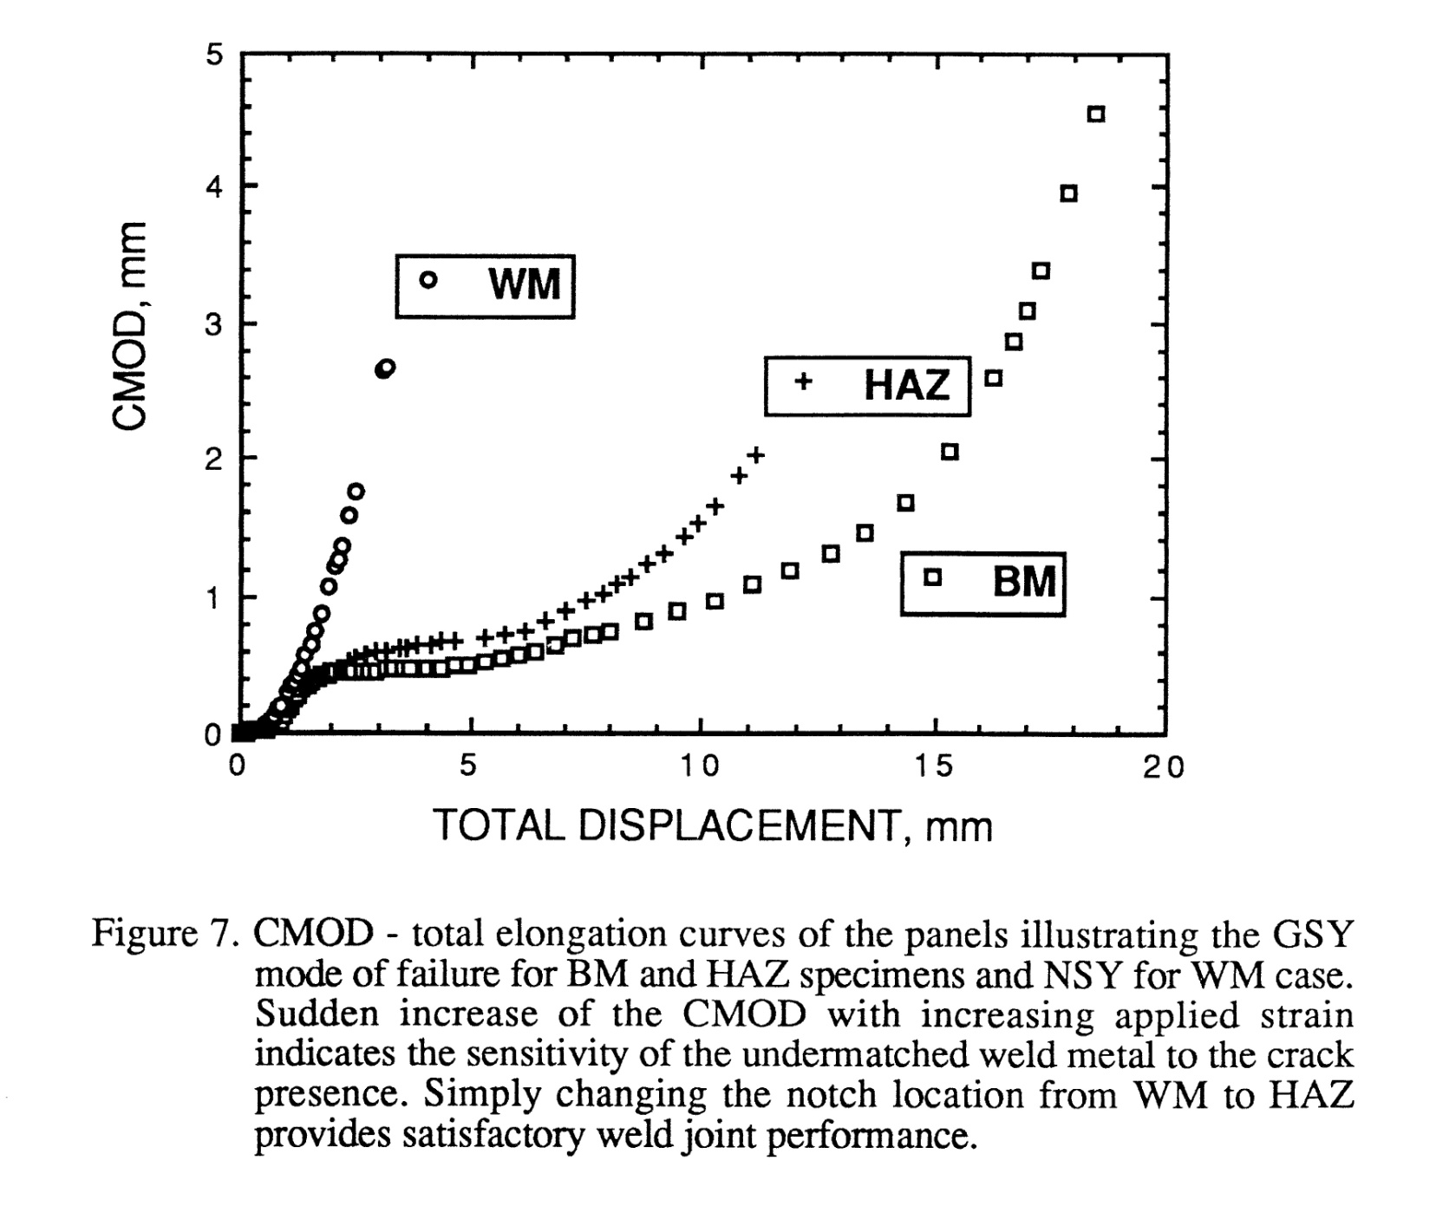
PROMENA CMOD SA IZDUŽENJEM

Slide 13
PROMENA SILE SA CMOD U TOKU EKSPERIMENTA
LOAD, V
CMOD, V

Slide 14
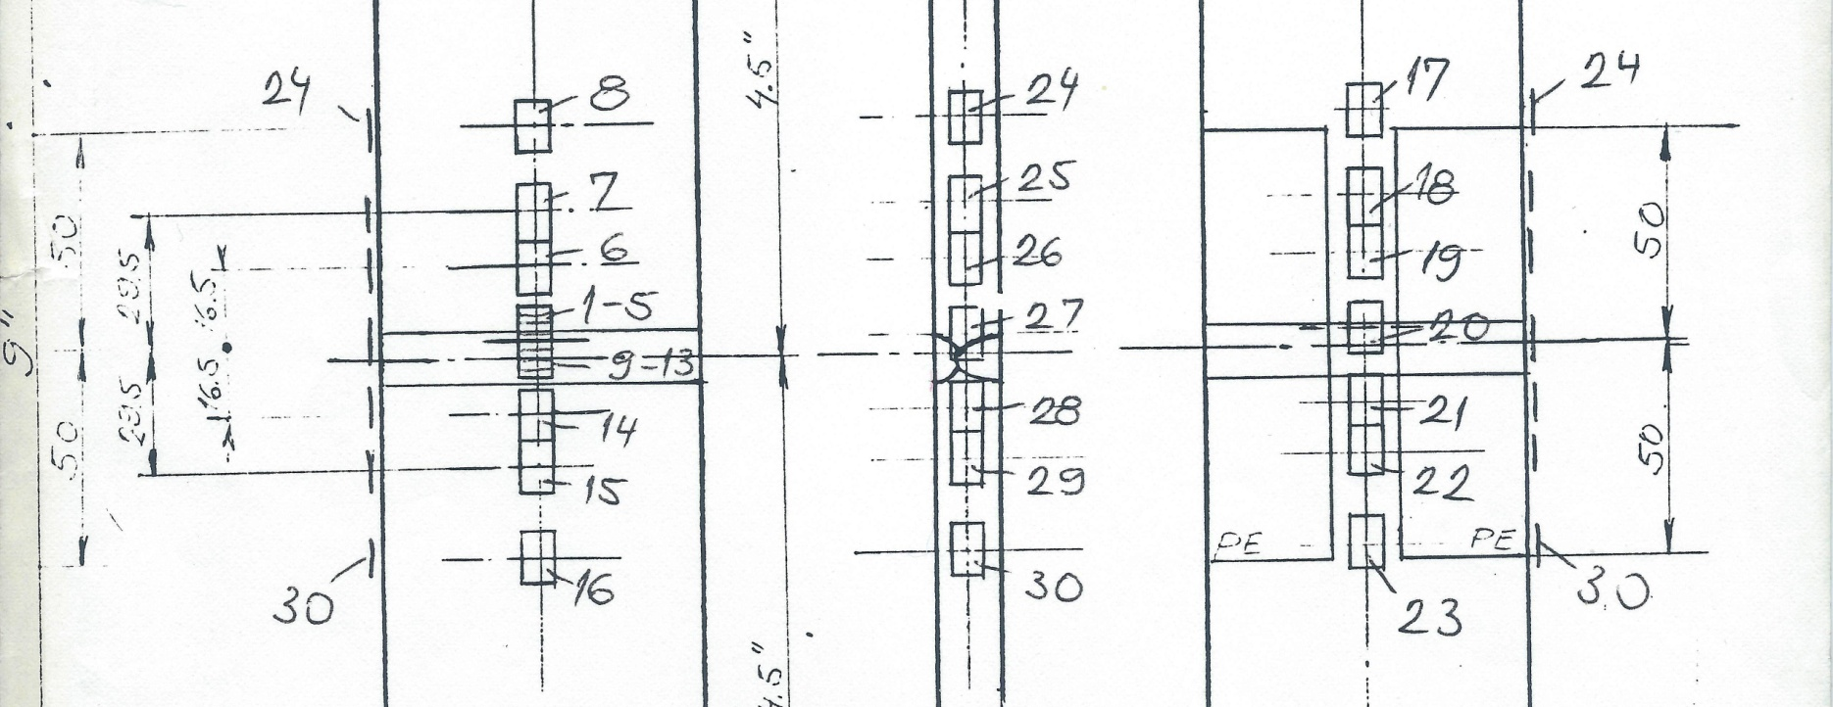

Slide 15
SG# | Distance | Distance | Distance | D.P.#1 | D.P.#2 | D.P.#3 | D.P.#4 | D.P.#5 | D.P.#6 | D.P.#7 | D.P.#8 | D.P.#9 | D.P.#10
 | on front | on back | on side
 | mm | mm | mm
16 | -50.0 |  |  | 3.000E-05 | 1.100E-04 | 2.100E-04 | 3.200E-04 | 4.300E-04 | 5.200E-04 | 6.500E-04 | 7.400E-04 | 8.500E-04 | 9.400E-04
15 | -29.5 |  |  | 1.000E-05 | 9.000E-05 | 1.900E-04 | 3.000E-04 | 4.000E-04 | 4.900E-04 | 6.100E-04 | 6.900E-04 | 7.900E-04 | 8.800E-04
14 | -16.5 |  |  | 1.000E-05 | 9.000E-05 | 1.900E-04 | 3.000E-04 | 4.000E-04 | 4.800E-04 | 6.100E-04 | 6.900E-04 | 7.900E-04 | 8.700E-04
13 | -8.6 |  |  | 2.000E-05 | 1.000E-04 | 2.000E-04 | 3.100E-04 | 4.100E-04 | 4.900E-04 | 6.200E-04 | 7.000E-04 | 8.000E-04 | 9.000E-04
12 | -7.2 |  |  | 2.000E-05 | 1.000E-04 | 2.000E-04 | 3.100E-04 | 4.000E-04 | 4.900E-04 | 6.200E-04 | 7.100E-04 | 8.000E-04 | 9.000E-04
1 1 | -5.8 |  |  | 1.000E-05 | 9.000E-05 | 1.800E-04 | 2.800E-04 | 3.700E-04 | 4.500E-04 | 5.600E-04 | 6.400E-04 | 7.300E-04 | 8.100E-04
10 | -4.4 |  |  | -1.000E-05 | 6.000E-05 | 1.500E-04 | 2.400E-04 | 3.200E-04 | 3.900E-04 | 4.900E-04 | 5.700E-04 | 6.400E-04 | 7.100E-04
9 | -3.0 |  |  | -2.000E-05 | 3.000E-05 | 1.000E-04 | 1.600E-04 | 2.300E-04 | 2.800E-04 | 3.600E-04 | 4.100E-04 | 4.600E-04 | 5.000E-04
0 | 0.0 |  |  | 0.000E+00 | 0.000E+00 | 0.000E+00 | 0.000E+00 | 0.000E+00 | 0.000E+00 | 0.000E+00 | 0.000E+00 | 0.000E+00 | 0.000E+00
1 | 3.0 |  |  | -4.022E-06 | 5.923E-05 | 1.351E-04 | 2.186E-04 | 2.971E-04 | 3.679E-04 | 4.590E-04 | 5.222E-04 | 5.905E-04 | 6.614E-04
2 | 4.4 |  |  | -1.326E-06 | 7.458E-05 | 1.631E-04 | 2.600E-04 | 3.500E-04 | 4.300E-04 | 5.300E-04 | 6.100E-04 | 6.900E-04 | 7.800E-04
3 | 5.8 |  |  | 0.000E+00 | 8.000E-05 | 1.700E-04 | 2.700E-04 | 3.600E-04 | 4.300E-04 | 5.400E-04 | 6.200E-04 | 7.000E-04 | 7.900E-04
4 | 7.2 |  |  | 1.000E-05 | 9.000E-05 | 1.800E-04 | 2.800E-04 | 3.700E-04 | 4.500E-04 | 5.600E-04 | 6.400E-04 | 7.300E-04 | 8.200E-04
5 | 8.6 |  |  | 1.000E-05 | 1.000E-04 | 1.900E-04 | 3.100E-04 | 4.000E-04 | 5.000E-04 | 6.200E-04 | 7.100E-04 | 7.900E-04 | 9.000E-04
6 | 16.5 |  |  | 1.000E-05 | 9.000E-05 | 1.900E-04 | 3.000E-04 | 4.100E-04 | 4.900E-04 | 6.100E-04 | 7.000E-04 | 7.900E-04 | 8.900E-04
7 | 29.5 |  |  | 2.000E-05 | 1.100E-04 | 2.000E-04 | 3.200E-04 | 4.200E-04 | 5.100E-04 | 6.400E-04 | 7.200E-04 | 8.200E-04 | 9.200E-04
8 | 50.0 |  |  | 2.000E-05 | 1.100E-04 | 2.100E-04 | 3.200E-04 | 4.300E-04 | 5.200E-04 | 6.500E-04 | 7.400E-04 | 8.400E-04 | 9.400E-04
23 |  | -50.0 |  | 2.000E-05 | 1.000E-04 | 2.000E-04 | 3.200E-04 | 4.200E-04 | 5.100E-04 | 6.400E-04 | 7.300E-04 | 8.300E-04 | 9.200E-04
22 |  | -29.5 |  | 1.000E-04 | 1.800E-04 | 2.800E-04 | 4.000E-04 | 5.200E-04 | 6.200E-04 | 7.800E-04 | 8.900E-04 | 1.030E-03 | 1.150E-03
21 |  | -16.5 |  | 8.000E-05 | 1.600E-04 | 2.600E-04 | 3.800E-04 | 4.800E-04 | 5.900E-04 | 7.300E-04 | 8.300E-04 | 9.500E-04 | 1.080E-03
20 |  | 0.0 |  | 1.000E-04 | 1.800E-04 | 2.800E-04 | 3.900E-04 | 4.900E-04 | 6.000E-04 | 7.400E-04 | 8.500E-04 | 9.800E-04 | 1.100E-03
19 |  | 16.5 |  | 4.000E-05 | 1.200E-04 | 2.200E-04 | 3.400E-04 | 4.400E-04 | 5.300E-04 | 6.600E-04 | 7.600E-04 | 8.700E-04 | 9.700E-04
18 |  | 29.5 |  | 3.000E-05 | 1.000E-04 | 2.100E-04 | 3.200E-04 | 4.200E-04 | 5.100E-04 | 6.400E-04 | 7.300E-04 | 8.400E-04 | 9.300E-04
17 |  | 50.0 |  | 2.000E-05 | 1.000E-04 | 2.000E-04 | 3.200E-04 | 4.200E-04 | 5.100E-04 | 6.400E-04 | 7.200E-04 | 8.300E-04 | 9.200E-04
30 |  |  | -50.0 | 2.000E-05 | 1.100E-04 | 2.100E-04 | 3.300E-04 | 4.400E-04 | 5.200E-04 | 6.700E-04 | 7.600E-04 | 8.700E-04 | 9.600E-04
29 |  |  | -29.5 | 3.000E-05 | 1.300E-04 | 2.400E-04 | 3.500E-04 | 4.700E-04 | 5.400E-04 | 7.100E-04 | 8.000E-04 | 9.200E-04 | 1.030E-03
28 |  |  | -16.5 | 3.000E-05 | 1.200E-04 | 2.300E-04 | 3.500E-04 | 4.600E-04 | 5.400E-04 | 6.900E-04 | 7.900E-04 | 8.900E-04 | 1.010E-03
27 |  |  | 0.0 | 3.000E-05 | 1.300E-04 | 2.300E-04 | 3.400E-04 | 4.600E-04 | 5.400E-04 | 6.900E-04 | 7.800E-04 | 8.800E-04 | 9.900E-04
26 |  |  | 16.5 | 2.000E-05 | 1.200E-04 | 2.300E-04 | 3.500E-04 | 4.700E-04 | 5.500E-04 | 6.900E-04 | 8.000E-04 | 9.000E-04 | 1.010E-03
25 |  |  | 29.5 | 1.000E-05 | 1.100E-04 | 2.200E-04 | 3.400E-04 | 4.400E-04 | 5.300E-04 | 6.800E-04 | 7.700E-04 | 8.700E-04 | 9.800E-04
24 |  |  | 50.0 | 1.000E-05 | 1.000E-04 | 2.200E-04 | 3.300E-04 | 4.400E-04 | 5.400E-04 | 6.700E-04 | 7.700E-04 | 8.700E-04 | 9.700E-04
Stress, Mpa |  |  |  | 4.672E+00 | 2.286E+01 | 4.482E+01 | 6.879E+01 | 9.157E+01 | 1.108E+02 | 1.385E+02 | 1.575E+02 | 1.799E+02 | 2.002E+02
GLSTRN (LVDT) |  |  |  | 1.000E-05 | 1.000E-04 | 2.100E-04 | 2.900E-04 | 4.000E-04 | 4.900E-04 | 6.100E-04 | 6.900E-04 | 7.900E-04 | 8.700E-04
CMOD, mm |  |  |  | 0.000E+00 | 8.200E-04 | 1.450E-03 | 2.000E-03 | 3.000E-03 | 3.000E-03 | 4.000E-03 | 5.000E-03 | 5.000E-03 | 6.000E-03
RES J, N/mm |  |  |  | 2.400E-02 | 2.900E-02 | 5.700E-02 | 1.070E-01 | 1.950E-01 | 2.740E-01 | 4.030E-01 | 5.100E-01 | 6.720E-01 | 8.760E-01
GLSTRN (SG) |  |  |  | 4.000E-05 | 1.200E-04 | 2.200E-04 | 3.300E-04 | 4.400E-04 | 5.300E-04 | 6.600E-04 | 7.600E-04 | 8.600E-04 | 9.700E-04

Slide 16
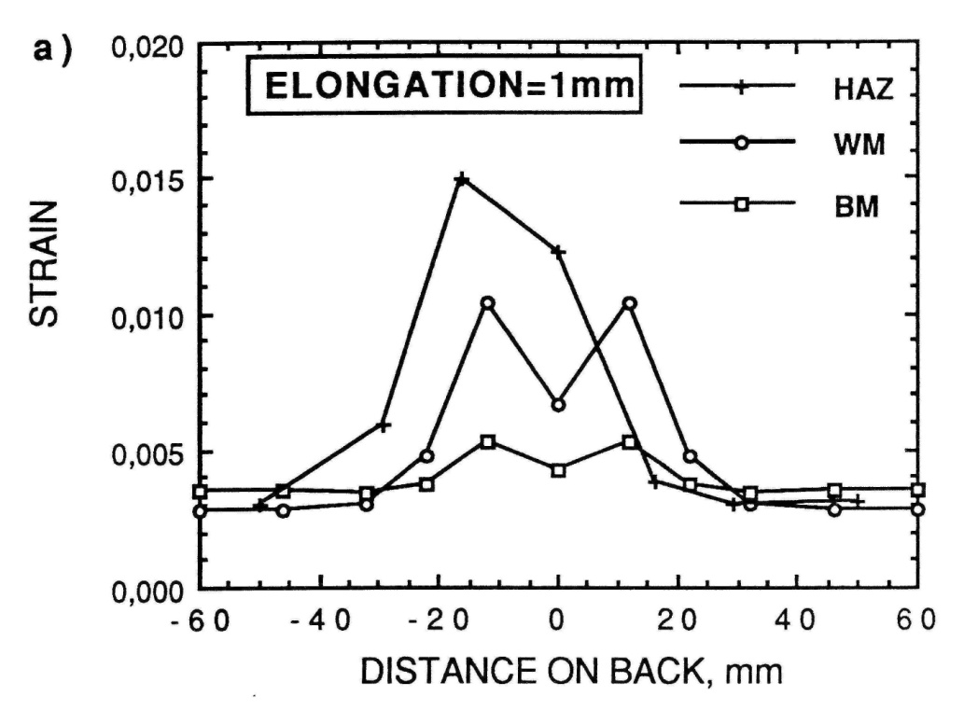
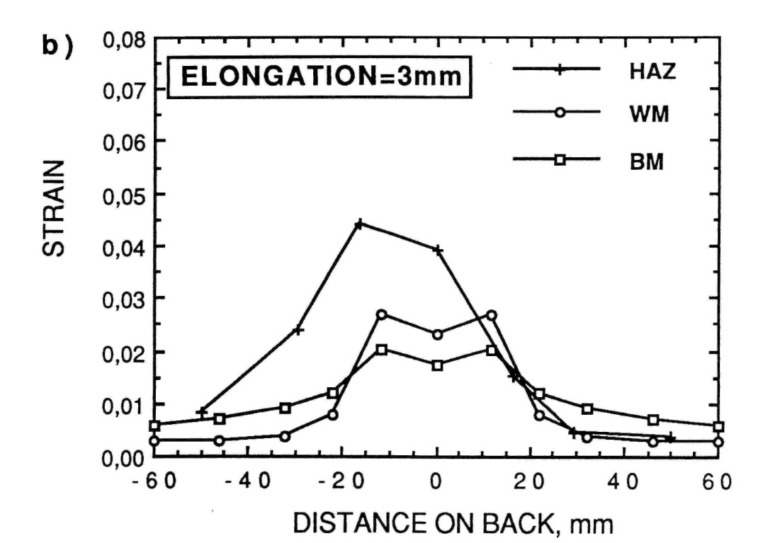
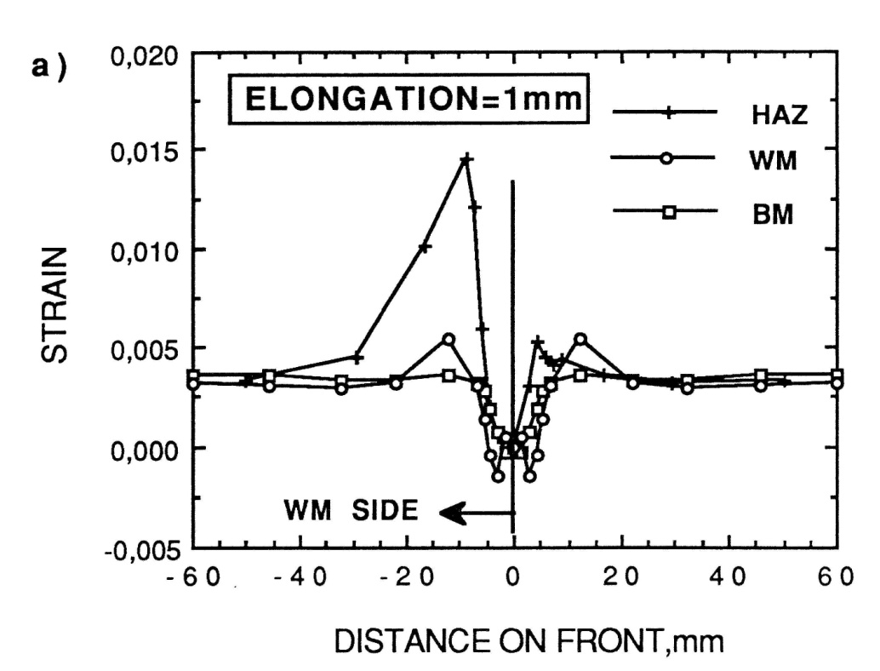
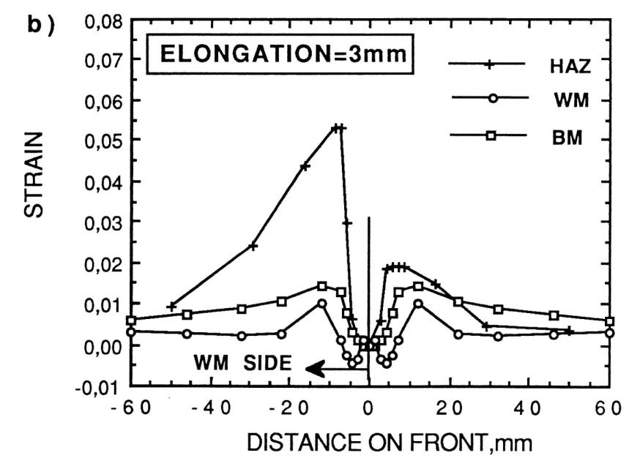
Figure 8. Distribution of plastic starains across the weld and along the panel obtained for a) 1 mm, b) 3 mm elongations

Slide 17
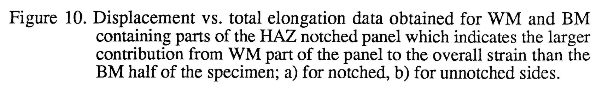
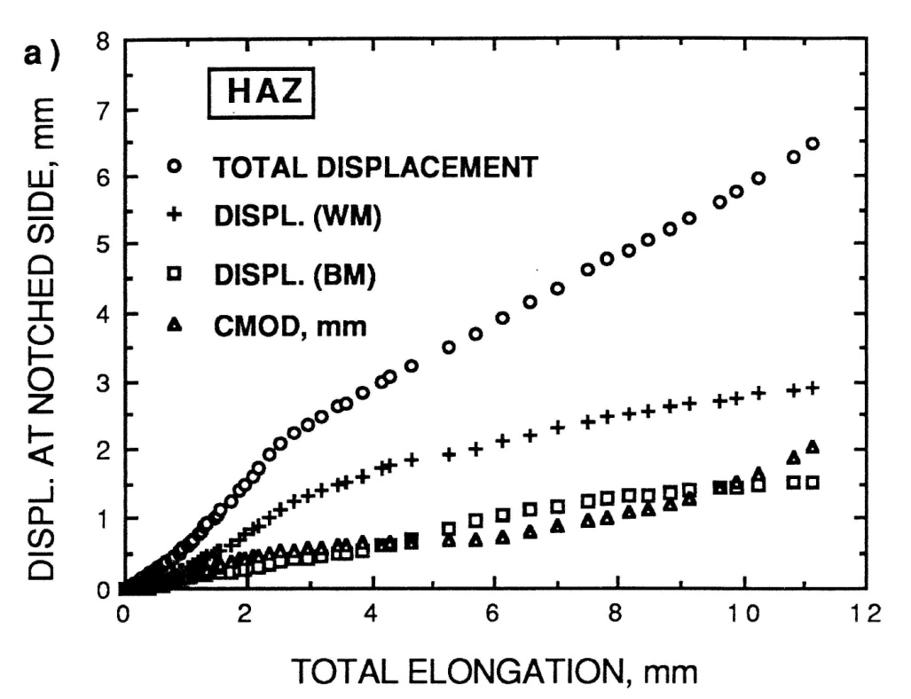
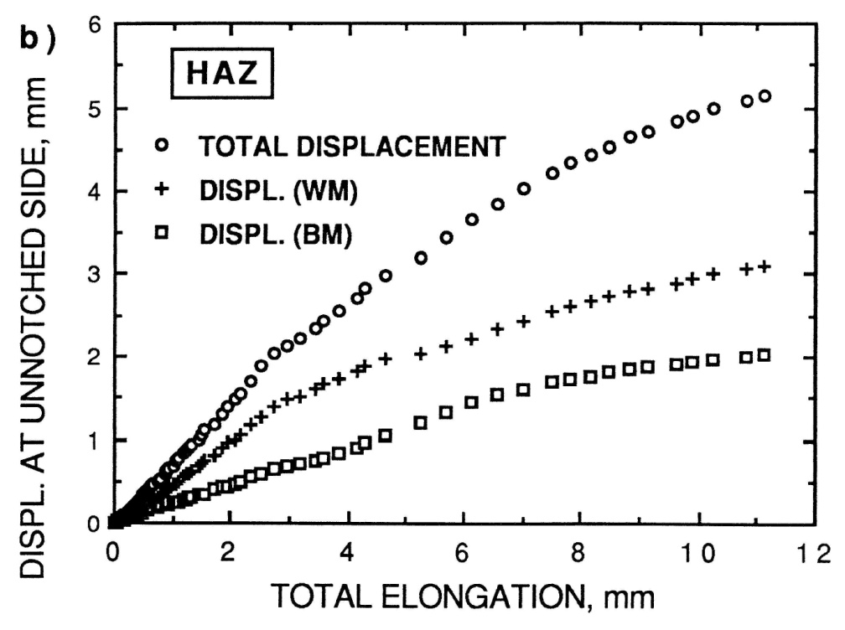

Slide 18
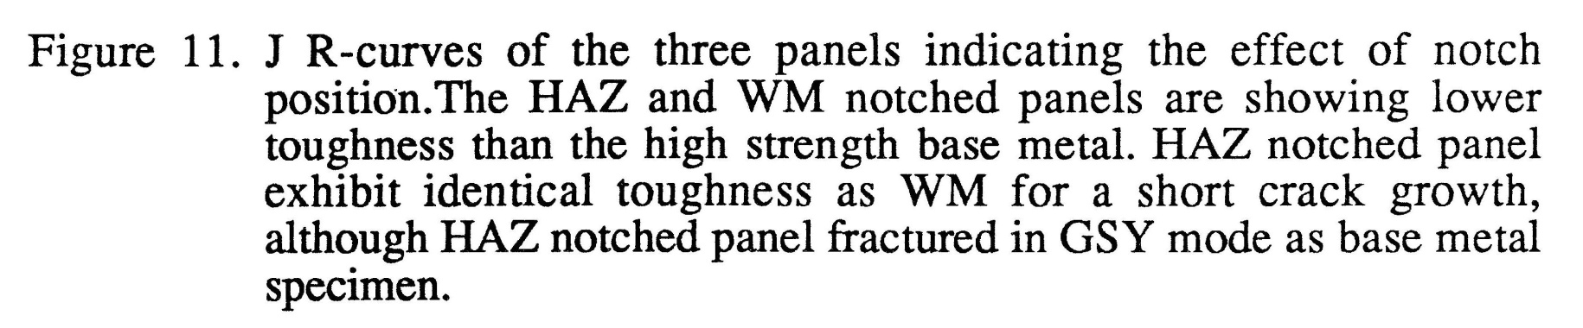
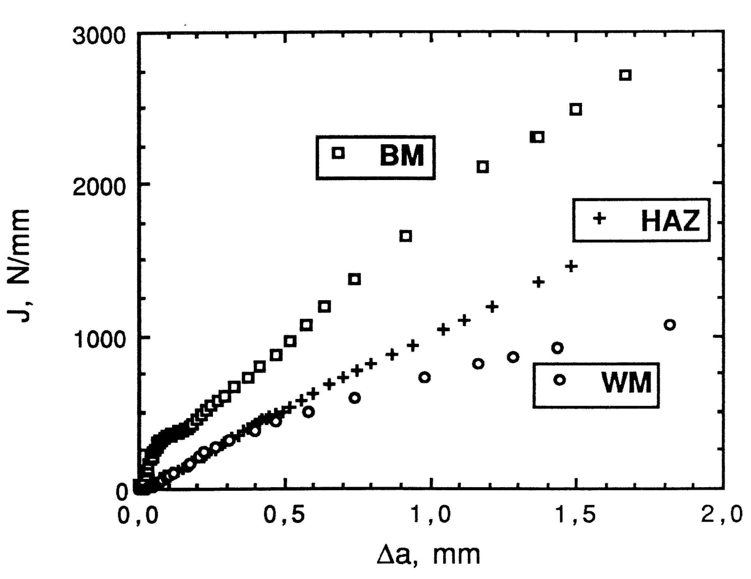

Slide 19
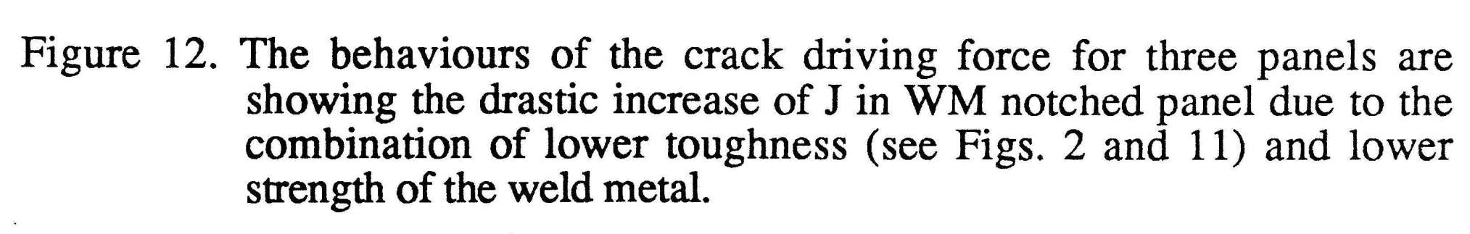
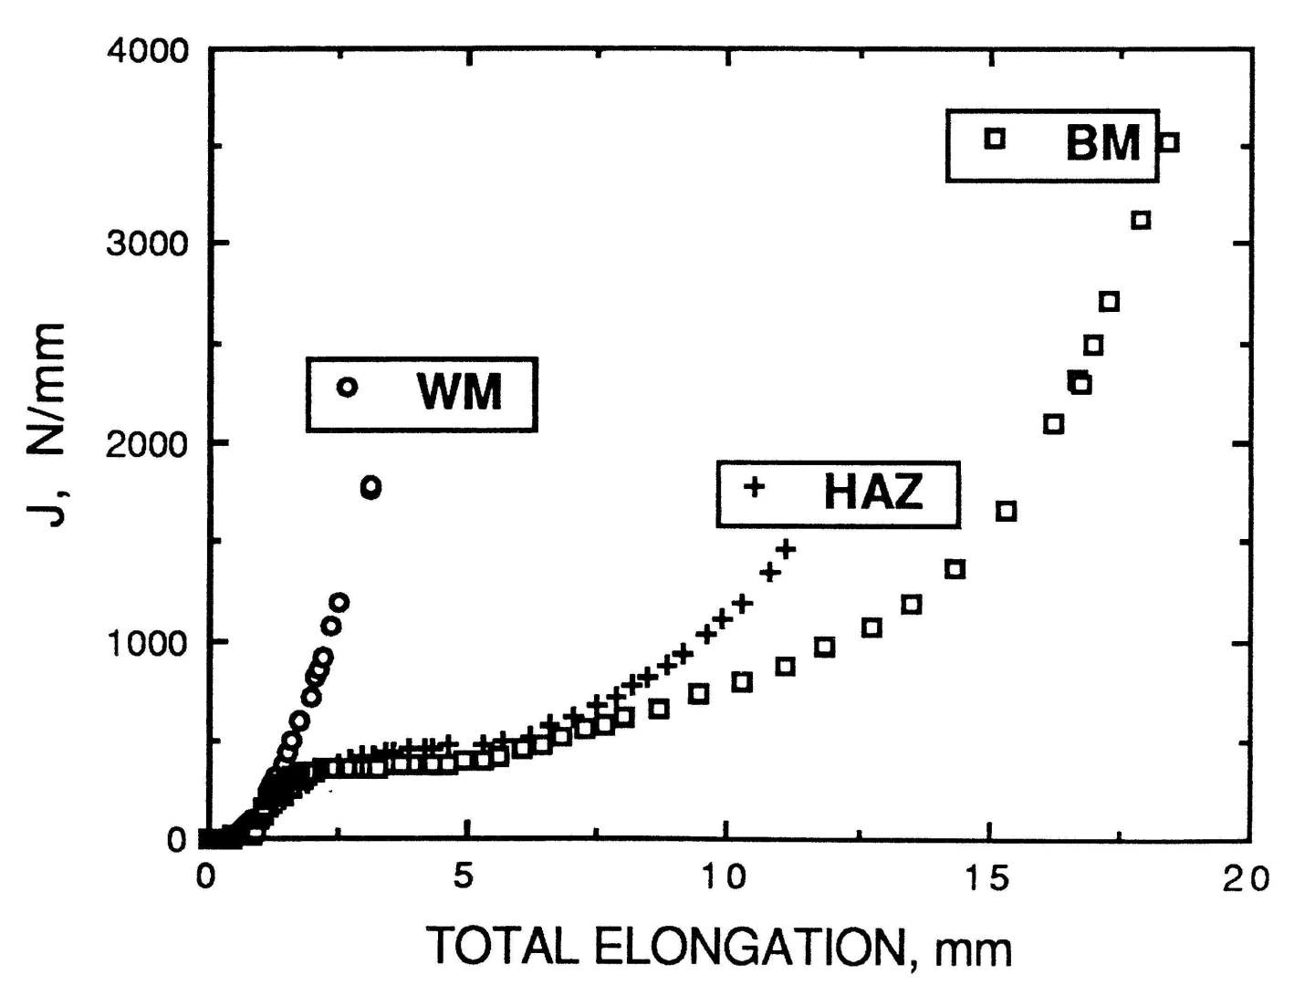

Slide 20
KRAJ EKSPERIMENTA, FOTO-ELASTIČNA FOLIJA POKAZUJE RASPODELU PLASTIČNE DEFORMACIJE

